Slide 1
Procedure to leverage joint research activities 2024
By Alix Blouët – WP3 Coordinator
Alix.blouet@univ-angers.fr
03.09.2024
Funded by the European Union under Agreement nº 101089896. Views and opinions expressed are however those of the author(s) only and do not necessarily reflect those of the European Union or European Union or European Education and Culture Executive Agency (EACEA). Neither the European Union nor the granting authority can be held responsible for them.
Notes:
Hay que elegir o ésta o la anterior

Slide 2
The necessary documents
Outline
Basics
Calendar
Let’s get into details: Pillar 1 & 3 Incentive for collaborative research projects & scientific conferences
Let’s get into details: Pillar 2 Researcher mobility program
Questions
The bill of specification
The application forms
The financial form
All available here : https://wp3eugreen.univ-angers.fr/en/index.html

Slide 3
1. Basics
EU GREEN has established a yearly joint procedure for proposals to stimulate research collaboration among our 9 universities. Researchers from EU GREEN partner universities can submit proposals for seed funding. This procedure, implemented by the Work Package Research (WP3), is intended to leverage cooperation between researchers and create new or consolidate existing scientific relationships. Its vision is to build robust scientific communities among the EU GREEN universities.
There are 3 pillars for the 2024 call:
Incentive for collaborative research activities, up to 20,000€
Researcher mobility program, up to 2000€ per mobility per person
EU GREEN Scientific conferences, up to 10,000€

Slide 4
2. Calendar
(common for the 3 pillars)
Application open | 2nd of September 2024
1st online information session | 3rd of September 2024 from 10 am to 11 am CET Click here to join
2nd online information session | 10th of October 2024 from 10 am to 11 am CET Click here to join
Application close | 2nd of November 2024, 10 PM CET

Slide 5
Clusters will provide an opinion on how the projects submitted fit into the cluster’s activities and scope to show the relevance and the work done together by the applicants and the cluster. WP3 team will send the relevant applications to the clusters. | Week 45/46 It’s up to the clusters to get organised to set up the meeting and the redaction of the opinion.
Deadline to send the cluster opinions to eugreenwp3@univ-angers.fr | November 15th 2024, 10 PM CET
Joint Research commission – Seed funding selection | 05th of December 2024 from 2 pm to 4 pm CET
Notification to applicants | Before the 30th of December 2024
Latest date for projects to start | 1st of January 2025
Latest date for project to end | 31st of December 2026
Final report due | 31st of January 2027

Slide 6
Clusters are not closed boxes. Your project can fit !
CLUSTER | CONTACT
Cluster 1 Emerging paradigms for health and wellbeing | Mariana Muresan (she/her) mmuresan@uoradea.ro Tomina Saveanu (she/her) tomina.saveanu@gmail.com
Cluster 2 Agriculture, food and environmental sustainability | Elena Maestri (she/her) elena.maestri@unipr.it Federico Righi (he/him) federico.righi@unipr.it
Cluster 3 Engineering and technology for sustainable development | Ulrich Krause (he/him ulrich.krause@ovgu.de
Cluster 4 Sustainable tourism for cultural and natural heritage | Junwei Yu (he/him) junwei.yu@univ-angers.fr
Cluster 5 Education sciences for sustainable development | Assunçao Folque (she/her) mafm@uevora.pt
Cluster 6 Challenges in ecosystem biodiversity and function, A macroregional evaluation | Victor Rolo (he/him) rolo@unex.es

Slide 7
Tip
Contact the relevant cluster leader as soon as possible, even if your idea is not fully formed.
Why? an opinion is asked from the cluster and will be taken into account for the evaluation :
“Clusters will provide an opinion on how the projects submitted fit into the cluster’s activities and scope to show the relevance and the work done together by the applicants and the cluster. WP3 team will send the relevant applications to the clusters.”
It allows the JRC to have an overview of what the project will bring to the cluster.

Slide 8
Pillar 1 & 3 Incentive for collaborative research projects & scientific conferences
3. Let’s get into details :
Objective : structure collaboration between the EU GREEN partners in research

Slide 9
This incentive won’t fund for projects in their own right; the laureates will be activities within a WP3 task.
The relevant fact is the objective of the activity that is being carried out, which should not be research per se
up to €20,000€
Incentive for collaborative research project
This action should support concrete exploratory collaborative activities by research teams with single or multiple disciplines that put forward the complementarity of competences and approaches to build other bigger projects to be submitted to external research funds. Those activities could facilitate travel and networking, information sharing, gaining access to data, preparing a larger publication on research outcomes, lead to the application to European projects (i.e. financing consortium meeting to prepare European application) or to the creation of new sub-group etc.

Slide 10
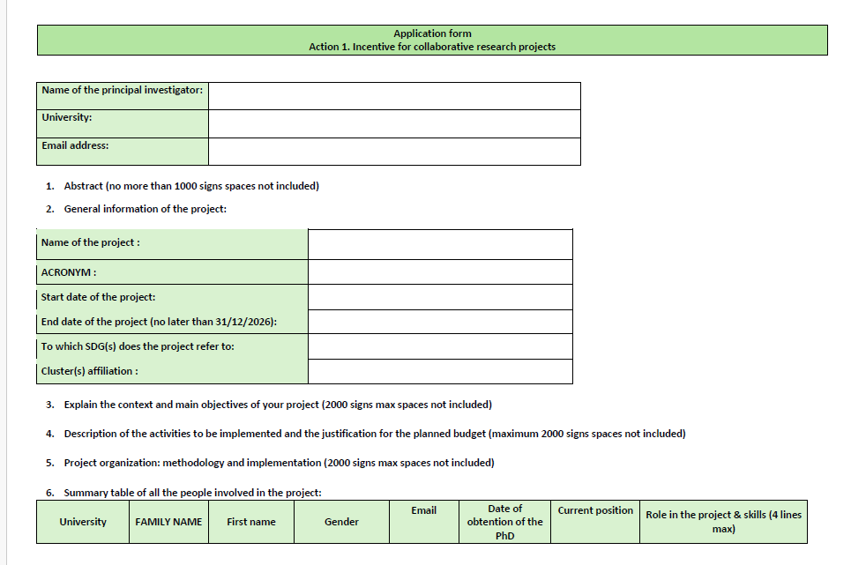
Application form

Slide 12
up to €10,000€ for organisation
Scientific conferences
This action should support the organisation of scientific conferences aligned with EU GREEN sustainability main theme and/or the cluster's scope. These funds can be used to either cover operating costs or support the travel of lecturers and/or participants.
The conference should be organised in one of the 9 EU GREEN universities and should forecast a detailed communication plan.
The budget may include the travel fees of the EU GREEN researchers to come to the conference.
As a result, indexed conference proceedings will be asked.

Slide 13
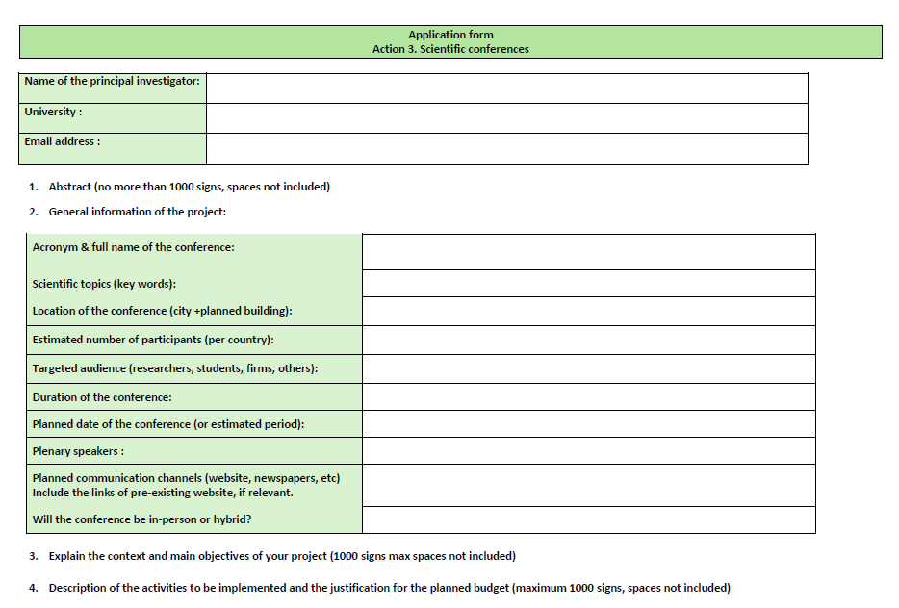

Slide 14
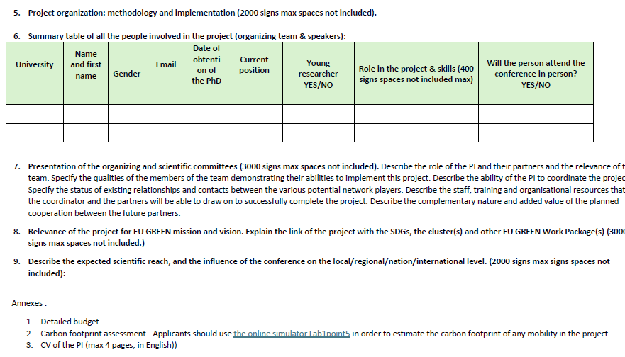

Slide 15
Check that your project…
…Has these mandatory elements :
3 EU GREEN partners at least | ✓
Number of EU GREEN clusters that are covered by the project | ✓
Will be completed within 2 years | ✓
Maximum budget respected | ✓
Answers sustainability challenges | ✓
No double funding | ✓
CV PI | ✓
Carbon footprint assessment | ✓
Use Lab1point5 to assess mobilities

Slide 16
Evaluation criteria
Common criteria | / 25
Relevance of the project for EU GREEN mission and vision and convincing argumentation of the EU GREEN added value of the intended collaboration | /10
Relation to cluster topics and number of clusters involved in the project | /10
Relation to other WPs | /5

Slide 17
Criteria specific action 1 & 3 | /55
Scientific excellence | /15
Participation of Early Career Researchers, graded as follows : - Participation of 3 ECR at least: 5/10 - Participation of more than 3 ECR: from 5 to 7/10 - Participation of more than 3 ECR + role as PI or local coordinator: from 7 to 10/10 | /10
Leverage potential (e.g. funding applications to international competitive calls for action 2.1) or sustainability of the collaboration (for action 2.3) | /10
Gender balance and gender dimension. A 50/50 repartition will lead to a 10/10 mark. Inequality in both ways will decrease the mark proportionally. | /10
Total per project | /80

Slide 18
Gender balance
Gender repartition in relation to the total number of participants | Grade
50/50 | 10/10
60/40 | 7/10
70/30 | 5/10
80/20 | 3/10
90/10 | 1/10
Example:
30 members in the project, 17 women, 13 men = 7/10
22 participants in the project, 5 men, 17 women = 3/10

Slide 19
In case of a tie, priorities will be given to project with:
(a) early career researchers
(b) The highest number of participating partners
Early career researchers are : master students, PhD students, those who finished their doctoral thesis less than 8 years ago.

Slide 20
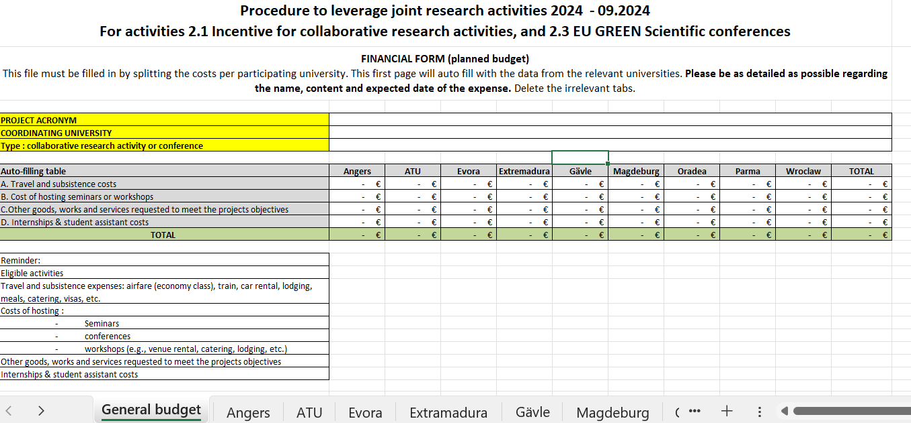

Slide 21
Some questions to ask yourself along the way :
Is the project aligned with the EU GREEN scope? (think clusters, SDGs, other Work Packages)
Have I been careful in designing an application that is not research oriented but which helps structure collaboration in research?
Is my project realistic & feasible before December 2026 ?
Have I clearly explained the role of each participant ?
Have I clearly explained the added value of the project and of the collaboration?
Have I clearly identified a European call to apply to ?
Have I payed attention to gender balance, have I included young researchers?

Slide 22
Pillar 2 Researcher mobility program
4. Let’s get into details :
Objective : structure bilateral collaboration between the EU GREEN partners in research

Slide 23
€2,000 per person (per person, per mobility)
Goal of the action 2.2 Researcher mobility program
Launch or reinforce research cooperation between EU GREEN institutions on
an individual (researchers),
intermediate (teams/medium scale projects)
or institutional level (research centres/large scale projects, PHD schools etc.)
Max per mobility will be granted to cover:
travel costs
accommodation
Food
Internal rules of each university still apply

Slide 24
Potential topics for a mobility
Find an expertise that doesn’t exist in your university
Share knowledge
Identify synergies
Identify potential calls to apply to
Plan the cosupervision of a student
Visit research facilities
Plan the organization of collaborative events & activities
…

Slide 25
Evaluation criteria
Common criteria | /25
Relevance of the project for EU GREEN mission and vision and convincing argumentation of the EU GREEN added value of the intended collaboration | /10
Relation to cluster topics and number of clusters involved in the project | /10
Relation to other WPs | /5
Specific criteria for action 2 | /15
A detailed programme of the activities to be developed during the visit. | /5
The expected outcomes of the mobility visit and next collaboration steps planned after the visit (i.e. visits regarding application to competitive funding) | /6
Participation of early career researchers (PhD and Postdoc) | /4
Total | /40

Slide 26
5. Questions ?

Slide 27
Information box
Find all information here (scroll down for the Q&A)
Subscribe to the monthly newsletter
Curious about the 2023 call? check the laureates here
Contact : eugreenwp3@univ-angers.fr
Still have questions? The next information session is on October 10th at 10 am CET. Link to join

Slide 28
Thank you !
Funded by the European Union under Agreement nº:101089896. Views and opinions expressed are however those of the author(s) only and do not necessarily reflect those of the European Union or European Union or European Education and Culture Executive Agency (EACEA). Neither the European Union nor the granting authority can be held responsible for them.
Notes:
Poner gracias en todos los idiomas

