Slide 1


//
Funded by the European Union under Agreement nº 101089896. Views and opinions expressed are however those of the author(s) only and do not necessarily reflect those of the European Union or European Union or European Education and Culture Executive Agency (EACEA). Neither the European Union nor the granting authority can be held responsible for them.
Notes:
Hay que elegir o ésta o la anterior

Slide 2
1. What are the main challenges that you encounter in the day-to-day activities?
Main Issue: Time constraints
Difficulty finding time for meetings and activities
Overlap with regular duties at home institutions
Limited engagement from wider research teams; only a core group participates
Challenges in motivating others to see the benefits of participation

Slide 3
2. What are the main strengths?
Main Strengths: Collaboration and diversity
Constructive, motivated, and collaborative work environment
Strong participation and faithful attendance from members
Wide range of expertise in ecology with diverse research interests
Good communication, open idea sharing, and active leadership
Potential for partnerships and new research initiatives across Europe

Slide 4
3. What do you think is missing?
Key Needs: Direction, participation, and engagement
Need for a long-term strategic plan or “grand plan”
More active researchers, especially from EU GREEN
Common research projects that unite members
Increased participant involvement and engagement
Broader engagement from partner universities

Slide 5
4. How do you envision the future?
Future Vision: Growth and sustainability
Continued collaboration but need for fresh members and leadership support
Integration of master’s and PhD students in research projects. Enhancing student mobility for traineeships
Development of joint research proposals and activities
Becoming a networking hub for projects and collaborations
Securing European funding (e.g., Horizon program) to maintain momentum

Slide 6
Which factors support it
What I have done
Vision
Which factors hinder it

Slide 7
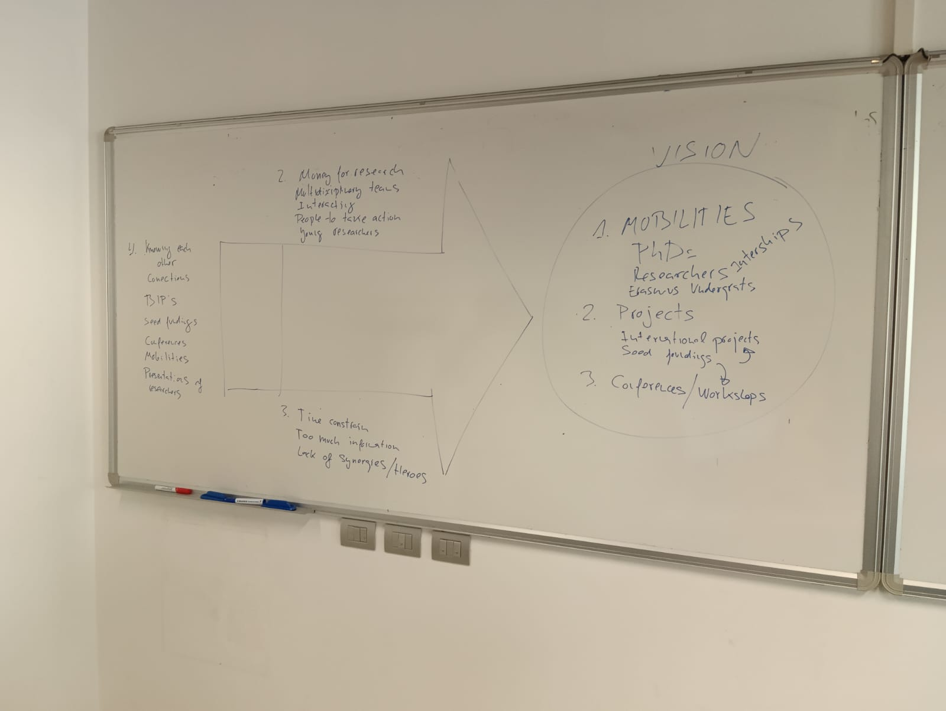

Slide 8

Funded by the European Union under Agreement nº:101089896. Views and opinions expressed are however those of the author(s) only and do not necessarily reflect those of the European Union or European Union or European Education and Culture Executive Agency (EACEA). Neither the European Union nor the granting authority can be held responsible for them.
Notes:
Poner gracias en todos los idiomas

