Slide 1
Research Week #2 - ATU
MSCA Doctoral Network - writing the proposal
Cristina Gallardo
Cristina.gallardo@Fundecyt-pctex.es
Funded by the European Union under Agreement nº 101089896. Views and opinions expressed are however those of the author(s) only and do not necessarily reflect those of the European Union or European Union or European Education and Culture Executive Agency (EACEA). Neither the European Union nor the granting authority can be held responsible for them.

Slide 2
Agenda
Two topics for today:
1st. Determine the process for the selection of the EU Green MSCA DN for 2024
2nd. Advance in the MSCA DN proposal from de PhD Council

Slide 3
1st . EU Green MSCA DN proposals for 2024
EU Green suported MSCA Doctoral Network propositions. We have two proposals to apply to the MSCA doctoral networks:
University of Gävle already working on a COFUND action for the next deadline on “Health-promoting working life” where the EU GREEN partners could be involved. More info from HiG is expected to request EU GREEN partners accordingly
The Department of Chemistry, Life Sciences and environmental Sustainability from Parma proposed to coordinate a topic on “Science and Technology for Environmental Regeneration » (MSCA DN). More info from Parma expected to request EU GREEN partners accordingly. The broad topic is considering as very inclusive and could involve most/all? of our universities.
Any other ideas and proposals coming from Universities and clusters may be supported by the PhD Council
proposals must be made before the summer holidays
A proposal from the SEED Project: Agribioped on alternative proteins from vegetable resources (CL2)
A continuation of SmartgySum project (CL3) ¿?
Deadline 31st of July?

Slide 4
Template to collect the DN proposals
UNIVERSITY
MSCA DN TYPE
Research Area
Other Universities already involved
Panel for the selection
Coming from a cluster or a seed Project? Which one?
Nº of Expected ESR
Nº of Months for each ESR
Contact Person
Department/Resarch Group
Abstract: Short summary (max. 2,000 characters, with spaces) to clearly explain: • the objectives of the proposal and expected outputs • • Relevance to EU Green Mission and Vision
Contact Person
Entity (link to website)
Management Office
International Support | Cristina.gallardo@fundecyt-pctex.es
Phone
E-mail

Slide 5
2nd topic for today: The MSCA DN proposal from the PhD C.
1 – Introduction and background
2 – Review of similar projects
3- Analysis of the call
4 – Proposals for the originality of the project
5 – Brainstorming Exercise: Finding the gaps
6 – Step by Step

Slide 7
Similar previous projects

Slide 8
Similar previous projects

Slide 9
Similar previous projects

Slide 10
2. Analysis of the call
Notes:
1. Submit a proposal for doctoral degrees awarded by the participating institutions.
PhD candidates must be enrolled in a joint programme and be jointly supervised.

Slide 18
Integration of our Associated Parners?

Slide 25
2024 Call
Opens May 29th
Deadline Nov 27th

Slide 26
Template: 30 pages
Excellence:
Quality and pertinence of the project’s research and innovation objectives
Soundness of the proposed methodology
Quality of the supervision:
Impact:
Contribution to structuring doctoral training at the European level and to strengthening European innovation capacity, including the potential for:
Credibility of the measures to enhance the career perspectives and employability of researchers and contribution to their skills development
Suitability and quality of the measures to maximise expected outcomes and impacts, as set out in the dissemination and exploitation plan, including communication activities
The magnitude and importance of the project’s contribution to the expected scientific, societal and economic impacts (project’s pathways towards impact)
Implementation:
Quality and effectiveness of the work plan
Assessment of risks and
Appropriateness of the effort assigned to work packages

Slide 32
4 – Proposals for the originality of the project:
Proposal 1: Definition of the main Project Idea: A Challenge Based Methodology

Slide 33
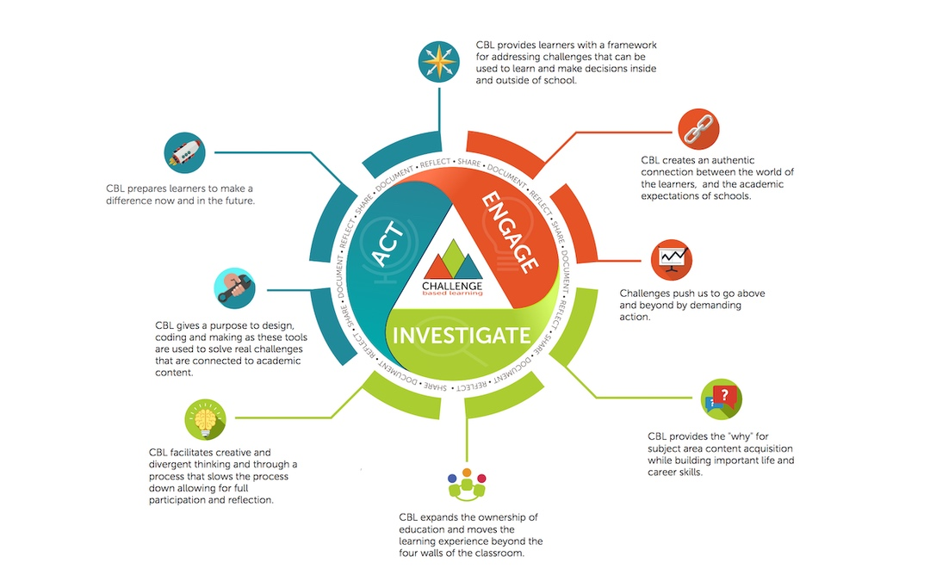
Proposal 1: Definition of the main Project Idea: A Challenge Based Methodology
Seach for experts in the field in our Universities to help in the process
Lauch a Challenge Based call addressed to the associated partners in the territory: ideas for strategies against rural depopulation to be solved by research in the proposal Phase + Expected outcomes from their perspective
Determine the 15 ESR (cover the 6 out of the basic 9 ESC based on excellence after the Challenge Based call with Associated Partners).
Continue with this methodology in the Project implementation phase with the ESR.

Slide 34
Why a Challenge Based Methodology for our Project?
One health
The theme of our planned COFUND is as mentioned “Health-promoting working life”. HiG have also discussed PhD program themes regarding: “Sustainable supply chains, natural hazards monitoring and mitigation, sustainable transport, sustainable urban planning, renewable energy” “Innovative Learning” “Digital transformation in SME”.
I expect any aligned to the 6 clusters of WP3
In principle all areas that are represented at OVGU and for which supervisors can be found e.g., engineering, informatics, psychology, political sciences, mathematics, natural sciences, medicine, citizen sciences etc. (all cluster)
An option from the Department of Chemistry, Life Sciences and environmental Sustainability is a topic on “Science and Technology for Environmental Regeneration »
Biodiversity; Agri-food; Renewable energies; Sustainable tourism; Energy storage; Circular economy; Health and life quality; Education and digitalization; Territorial fixation, rural development, entrepreneurship in rural environments, heritage (historical, cultural and natural)
Health and wellbeing; Bioeconomy; Smart materials and nanotechnologies; Collaborative Human-AI systems; Energy communities; Circular economy; Sustainable tourism.
Agriculture, food and environmental sustainability (cluster 2) and Challenges in ecosystem biodiversity and function (cluster 6): sustainable agriculture, agroecology, ecosystem biodiversity, sustainable food production.

Slide 35
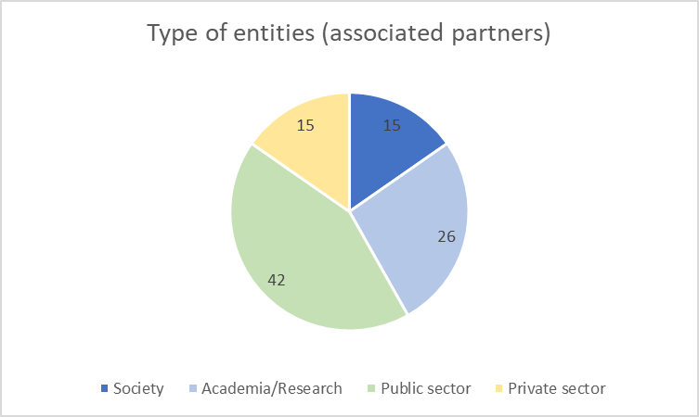
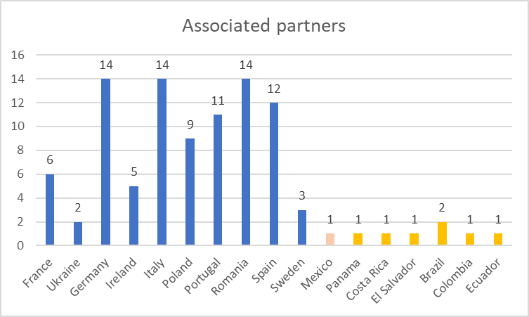

Slide 36
Steps for the ChB Methodology
Launch of the Challenge Based Call to Associated Partners: July to September 2024
Determine the Associated Partners to be involved on the Challenge Based Methodology: Early October 2024
Associated in EU Green Erasmus+ project as Beneficiaries or as associated in MSCA DN?

Slide 37
Proposal 2: doctoral co-tutelle as one our added value?

Slide 38
Brainstorming Exercise: Finding the gaps
 | What we do already have | What crucial aspects are missing/ weaknesses to overcome
Excellence
Impact
Implementation

Slide 39
Things to be done
WHAT | WHO | WHEN
Determination of a core group for the writting process: |  | Right now!
To create a teams channel within PhD Council | UEX | 1st week of July
Launch of the Challenge Based Call to Associated Partners |  | July to September
Determination of the linkages with the current doctoral programs in each University: selection, description and argumentation of the relationship based on the contents of the doctoral programmes |  | July
Launch a call for the better supervisors |  | From July to September
Individual Exploratory work on the measures to enhance the carrer perspectives of researchers | ALL | September
Description of the current contents of the Doctoral Training programs: | ALL | July
Proposal Training Program determination |  | October 2024
Gender, Open Practices, Research data management and management of other research outputs in each Uni. | ALL | September
Associated Partners to be involved based on the Challenge Based Methodology |  | Early October
European Contribution: How ambitious are we able to be? What compromises are we willing to make? | JRC | next meeting

Slide 41
Thank you for your attention!
Cristina Gallardo
Cristina.Gallardo@fundecyt-pctex.es
Funded by the European Union under Agreement nº:101089896. Views and opinions expressed are however those of the author(s) only and do not necessarily reflect those of the European Union or European Union or European Education and Culture Executive Agency (EACEA). Neither the European Union nor the granting authority can be held responsible for them.

