Slide 1
Campus as a Living Lab for
Research and Sustainability
WP3 + WP8
Agneta Morelli & Fiona Britton
Funded by the European Union under Agreement nº 101089896. Views and opinions expressed are however those of the author(s) only and do not necessarily reflect those of the European Union or European Union or European Education and Culture Executive Agency (EACEA). Neither the European Union nor the granting authority can be held responsible for them.

Slide 2
Background
WP8 Task 8.2 Definition of a strategy for the development of Sustainable Communities
This task is designed to define the best strategies and activities as well as to utilize each university as a Living lab for experimental sustainability practices.
WP3 Task 3.3.Support to Joint Research Projects
The Alliance’s research teams have exceptional expertise in a number of SDG-related fields and enjoy international recognition. We need this know-how to be put to full use by actively creating the spaces and conditions where cross-fertilization can happen, and new scientific questions can emerge and flourish across the 6 clusters and beyond.

Slide 3
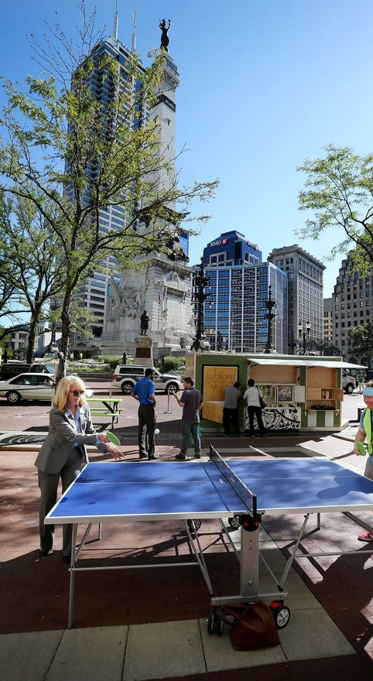
Campus as a Living lab
Collaborative Experimentation
Using the campus to demonstrate and test new ideas, approaches, technologies and solution in local contexts and at different scales.
Agent of Change
Working in partnership with industry, government and community to support exploration, collaboration and exchange of knowledge.
Training the Next Generation
Providing opportunities for students to build the skills for tomorrow while advancing sustainable solutions today.
Notes:
Campus as a Living Lab can be a platform that uses the university as a test-bed for the production of sustainability knowledge and practices and for innovation.
In the Campus Living lab the university campus is used to explore opportunities and test new ideas related to sustainable activities in a local context, while learning from both successes and failures.
Bring together researchers, teachers, staff, students and partners to improve our campuses and our communities beyond the institutional boundaries to fulfil our responsibility to transform to a sustainable society.

Slide 4
A campus that communicates sustainability
Open innovation ecosystems in real-life environments using iterative feedback processes/life cycle approach to create sustainable impact.
Key Attributes:
Co-creation
Test and validate in real world setting
Scale Up
Iterative process – learning & evolving!
- Adapted from European Network of Living Labs (ENOLL)

Slide 5
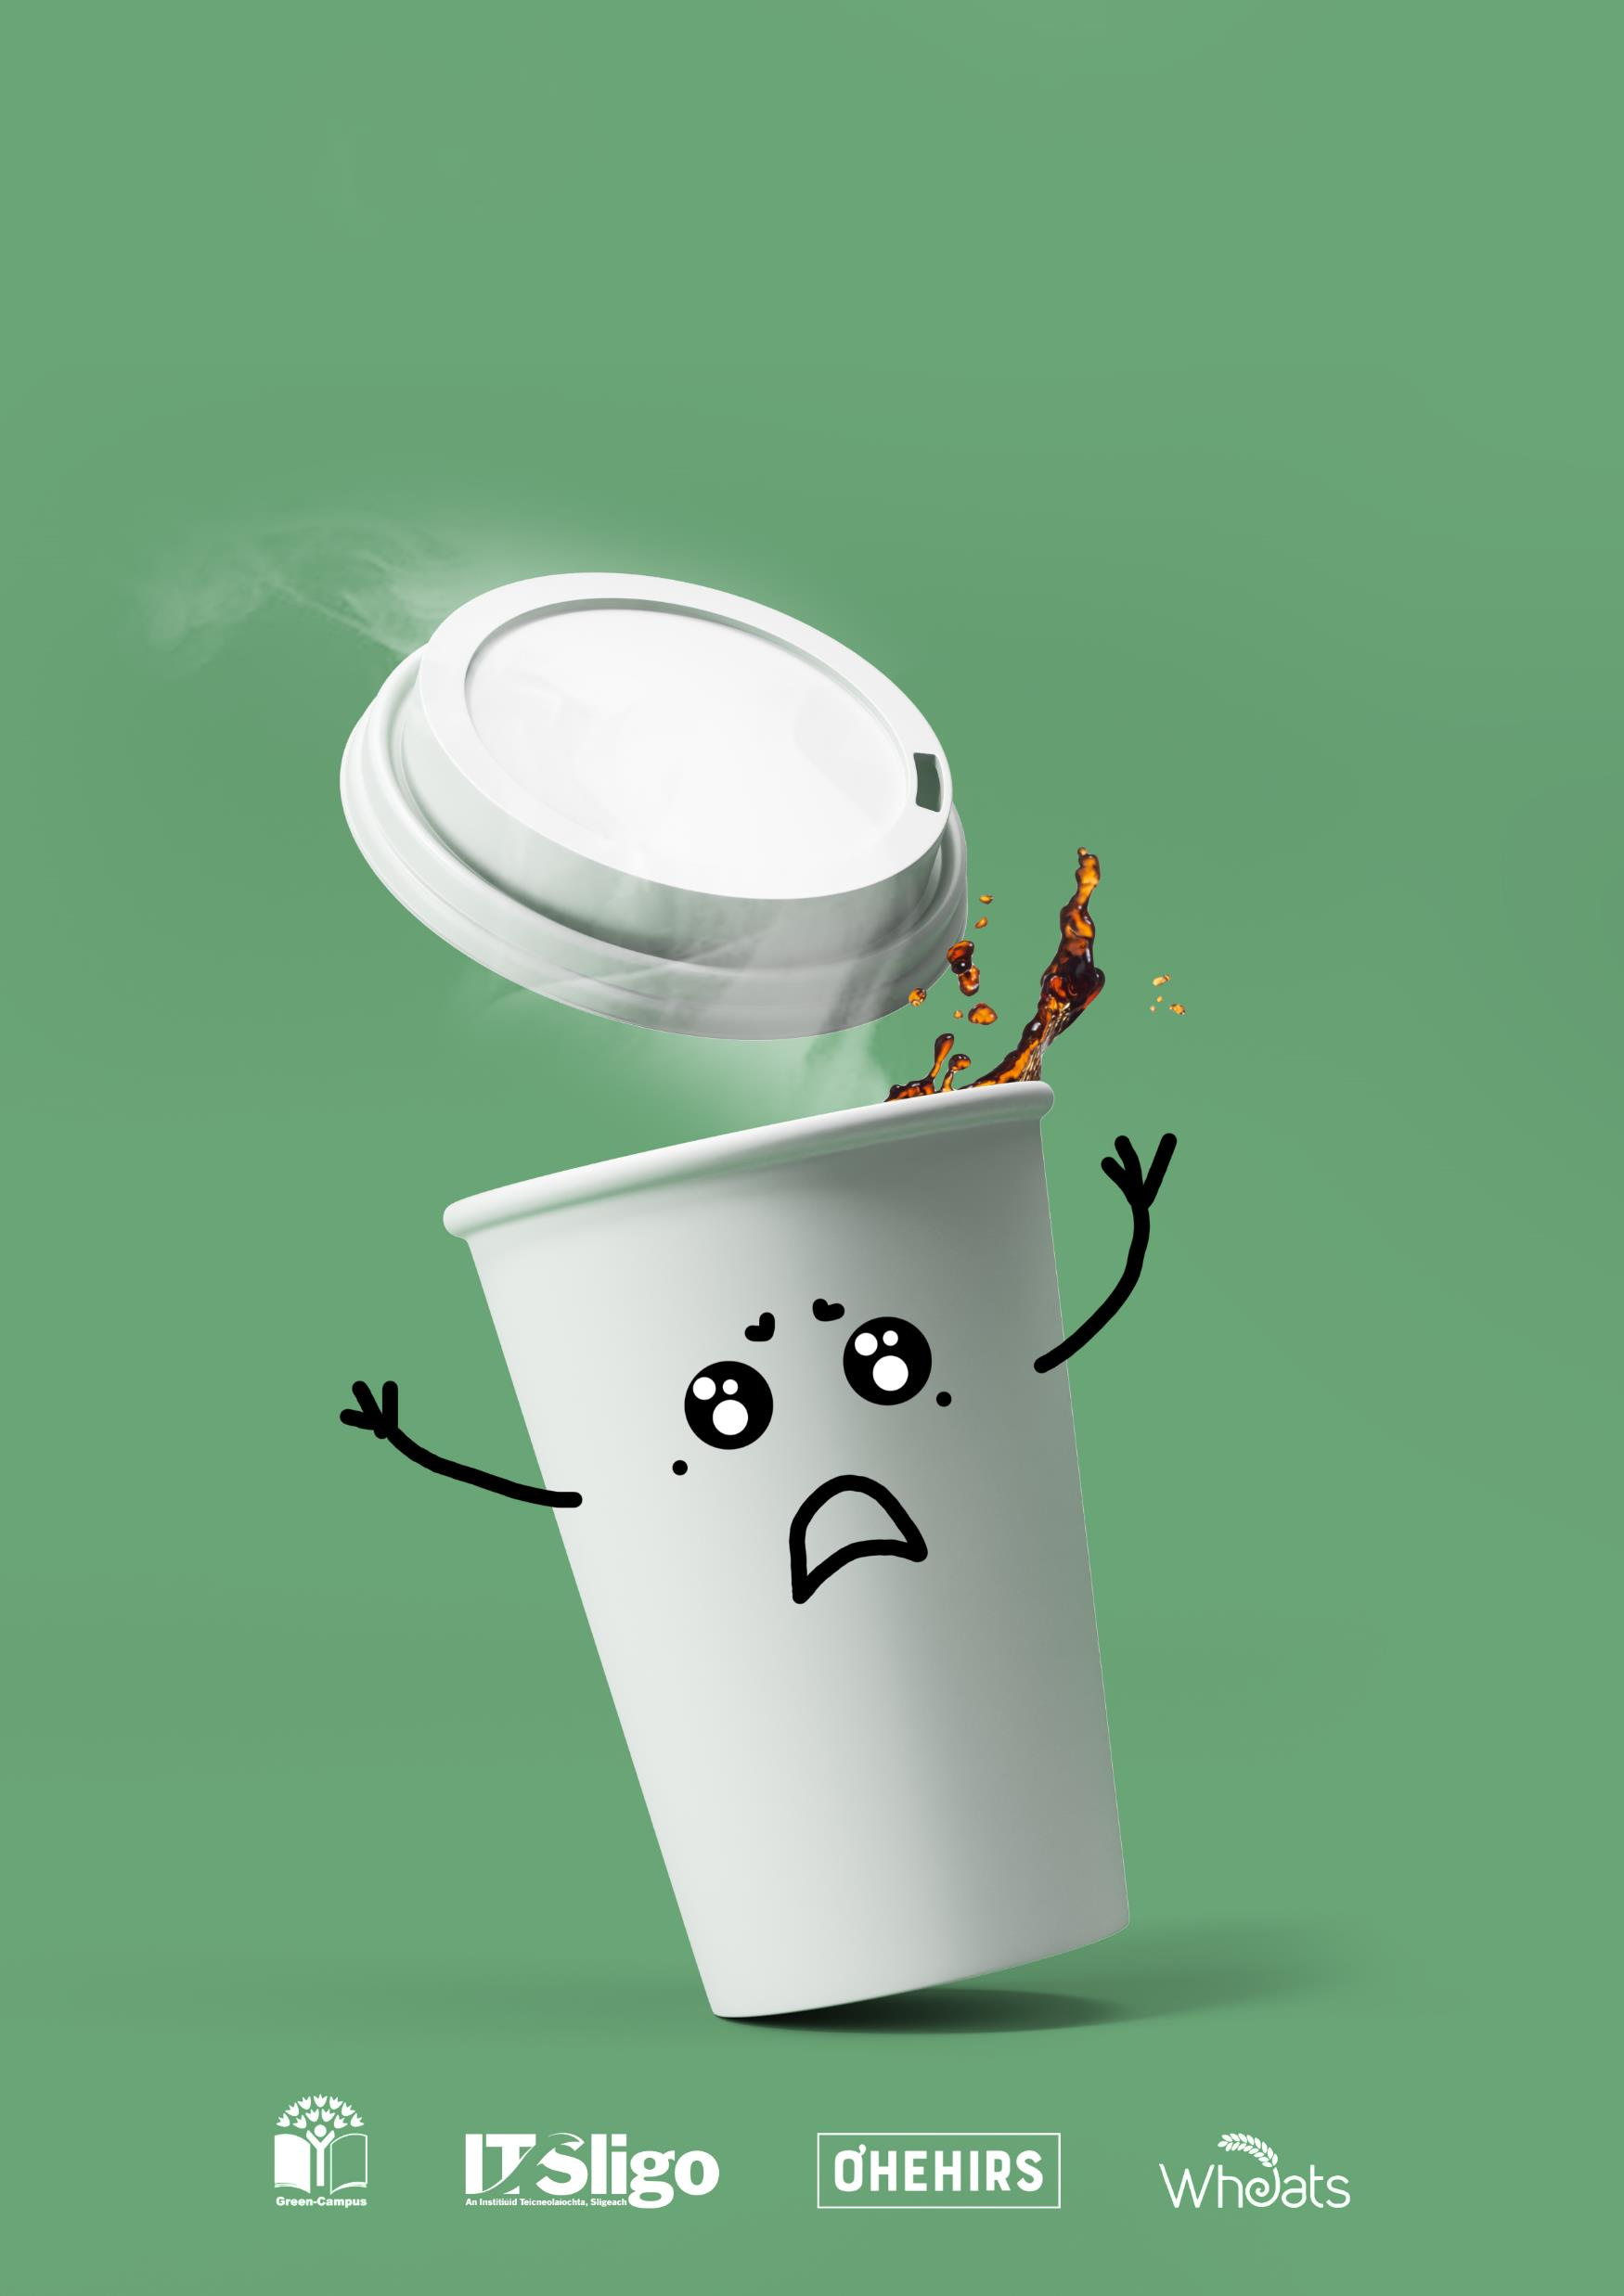
ATU Sligo: Campus Living Lab Example
‘Kill the Cup’: Elimination of disposable cups from campus
Multi-stakeholder approach
Co-production of knowledge
Environmental Science (Waste study)
Marketing Students (Attitudes)
Computing Students (App design – M&T)
Fine Art (Awareness campaign)
Test and monitor in real world setting
Reflexivity
Scale and roll out to wider community (Sligo County Council, Sligo Tidy Towns Committee).

Slide 6
Some examples from Alliance Partners
Engineers using campus as a test bed for their no-driver electric cars
Geo-chemists monitoring the chemistry of collected rooftop rainwater
Botanists teaching plant diversity using paths on campus
Ecologists using isolated wildflower areas with high turf to measure insects
Statisticians doing data exercises from campus experiments to test output
Limnologists measuring greenhouse gas exchange from constructed campus wetlands
Geologists monitoring groundwater quality in wells on campus
Health scientists studying student mental health on campus
Environmental psychologists measuring sound levels on campus
Notes:
Immunologist calculating forest bathing and stress reduction on campus

Slide 7
Objectives
Provide learning & engagement opportunities for students, staff, and faculty involving campus community members from a broad range of disciplines & backgrounds.
Expand research, innovation, and collaboration opportunities in partnership with external stakeholders on campus.
Advance knowledge and solutions to sustainability challenges by supporting campus operations and the campus community.
By being inclusive contribute to lasting benefits with a broad range of community partners.
Notes:
Sustainability projects combining operational and academic activities contributing to the Universities’ sustainability goals while providing an opportunity for research and experiential learning.
Students are directly involved in addressing real world sustainability problems of interest to the University, analysing the sustainability dimensions and implications of university policies, guidelines, and plans, and to propose improvements in line with good practices elsewhere.
Contribute to making our universities more attractive to students, staff, and faculty members.

Slide 8
Some Potential Benefits
Increased student motivation and engagement
Innovative collaborations with internal and external stakeholders
Attractive Campuses by translating sustainability research into university operations
Notes:
Student could obtain a variety of benefits, including:
Improved specialised skills and group collaboration skills
Application of knowledge and education in real-life situations
Networking opportunities in academia and with the campus community
Students and Stakeholders benefits
Connections to prospective industry professionals
Potential engagement with interested external partners
University organisational benefits
Add to a university sustainability profile
Gain interest from students and external stakeholders

Slide 9
Brainstorming
How are we currently using our campuses as living labs?
How can we work together to create living labs that catalyse sustainable change? (projects, research, teaching & learning, campus culture)
Mapping current Living Lab research activities?
Exploring internal and external interest and motivation?
Framing an attractive seed funding call?

Slide 10
Funded by the European Union under Agreement nº:101089896. Views and opinions expressed are however those of the author(s) only and do not necessarily reflect those of the European Union or European Union or European Education and Culture Executive Agency (EACEA). Neither the European Union nor the granting authority can be held responsible for them.
Notes:
Poner gracias en todos los idiomas

