Slide 1
MSCA Postdoctoral Fellowship
How to write a successful MSCA PF project proposal? 21.05.2024
Funded by the European Union under Agreement nº 101089896. Views and opinions expressed are however those of the author(s) only and do not necessarily reflect those of the European Union or European Union or European Education and Culture Executive Agency (EACEA). Neither the European Union nor the granting authority can be held responsible for them.
Notes:
Hay que elegir o ésta o la anterior

Slide 2
For the comfort of the meeting, please turn off your microphones during the presentation(s). If you have any questions, please ask them in the Q&A section or during the time allocated to questions.
Thank you!
Funded by the European Union under Agreement nº 101089896. Views and opinions expressed are however those of the author(s) only and do not necessarily reflect those of the European Union or European Union or European Education and Culture Executive Agency (EACEA). Neither the European Union nor the granting authority can be held responsible for them.
Notes:
Hay que elegir o ésta o la anterior

Slide 3
Agenda – 21.05.2024
Welcome and introductions
An overview of the MSCA PF proposal template – Jowita Chojcan (UPWr) and Anaëlle Gerard (University of Angers)
Dr Agnieszka Razim - Tips for writing the proposal (Life Sciences)
Dr Łukasz Sterczewski - Tips for writing the proposal (Exact Sciences)
Q&A

Slide 4
About EU GREEN
European Universities alliance for sustainability : Growth, Inclusive Education and ENvironment
9 partners :
University of Extremadura, Spain
University of Parma, Italy
University of’Angers, France
University of Magdeburg, Germany
Wroclaw University of Environmental and Life Sciences, Poland
University of Evora, Portugal
University of Gävle, Sweden
Atlantic Technological University, Ireland
University of Oradea, Romania

Slide 5
MSCA PF – Key resources
Next deadline : 11th of September 2024
Proposals get submitted on the Funding & Tenders portal
HE Main Work Programme 2023–2024 – 2. Marie Skłodowska-Curie Actions
HE MSCA PF Guide for Applicants
HE Programme Guide
Marie Skłodowska Curie Actions Green Charter
MSCA Guidelines on Supervision
HE Unit MGA v1.0 – Model Grant Agreement – it will be very useful when you get funding
Please note that all important documents are also available on the Funding and Tenders portal – link here (choose Conditions and Documents tab)

Slide 6
MSCA PF - The proposal structure
Part B – Scientific proposal
B1. Description (10 pages max):
1. Excellence (50% of score)
Research project (state of the art)
Project methodology
Interdisciplinarity, gender dimension, open science
Quality of supervision and training, complementarity of profiles
Achievements of the fellow
2. Impact (30% of score)
Impact of the project on the postdoc's career
Societal, economic and technological impacts of the project
Dissemination and communication activities
3. Implementation (20% of score)
The work plan incl. Gantt Chart, risks and hosting arrangements
Part A – Online form
Abstract
Administrative information, incl. Proposal title, Acronym, Scientific Panel, Descriptors, List of participants
Budget
Ethics and security
Part B2 (without a page limit)
CV of the fellow (max 5 pages)
Host organisation description
Letter of commitment (only for Global fellowship + placement)
Remember to attach part B1 and B2 as two separate PDFs

Slide 7
MSCA PF General tips – 1
Choose short and memorable Acronym. It can’t have an inappropriate meaning in English or in another language – e.g. DEMOTEC, TIME4CS
The call identifier should be used as a header on each page
Start with B1 - B2 and A (online forms) are easier and need less time to complete.
The B1 has a page limit (10 pages). You can work offline on it and remember to consult with your supervisor and us!
Use the proposal template provided including the exact subheadings
Do not delete the tags !
Do not add any cover page or table of contents!
Be aware of the overall weighting of each evaluation criterion and plan the number of pages accordingly e.g. Excellence (50% -app. 5 pages), Impact (30% -app. 3 pages), Implementation (20% -app. 2 pages).
Call identifier - HORIZON-MSCA-2024-PF-01

Slide 8
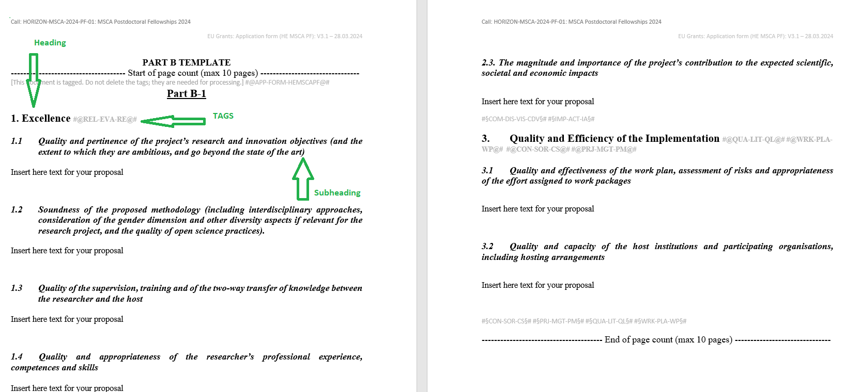
Notes:
1. Excellence – heading
1.1 Quality and pertinence of the project’s research and innovation objectives (and the extent to which they are ambitious, and go beyond the state of the art) – subheading
Excellence #@REL-EVA-RE@# - tags (in grey)

Slide 9
MSCA PF General tips – Proposal layout
Do not just use blocks of text – use charts, diagrams, text boxes, figures to explain aspects of the project
Organise your text into well-thought paragraphs
For example – where you discuss State-of-the-art and how your project objectives go beyond it, make sure each paragraph relates to the specific objective
Use the correct font type – Times New Roman (for Windows platforms) and size – 11 points, single line spacing and page margins of min 15 mm
For Apple use Times/Times New Roman (11) and for Linuks use Nimbus Roman No. 9L
Use highlighting – bold, underline, italics – but don’t overdo it!
Use tables for illustrating the core text of the proposal – these break up the text and save space (font size 8 is allowed) – the tables cannot contain the core text itself
Place literature references in footnotes, use font size 8 or 9

Slide 10
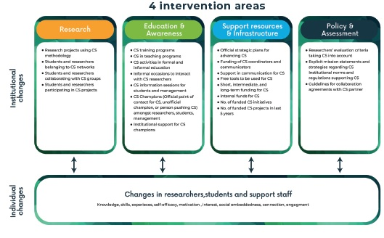
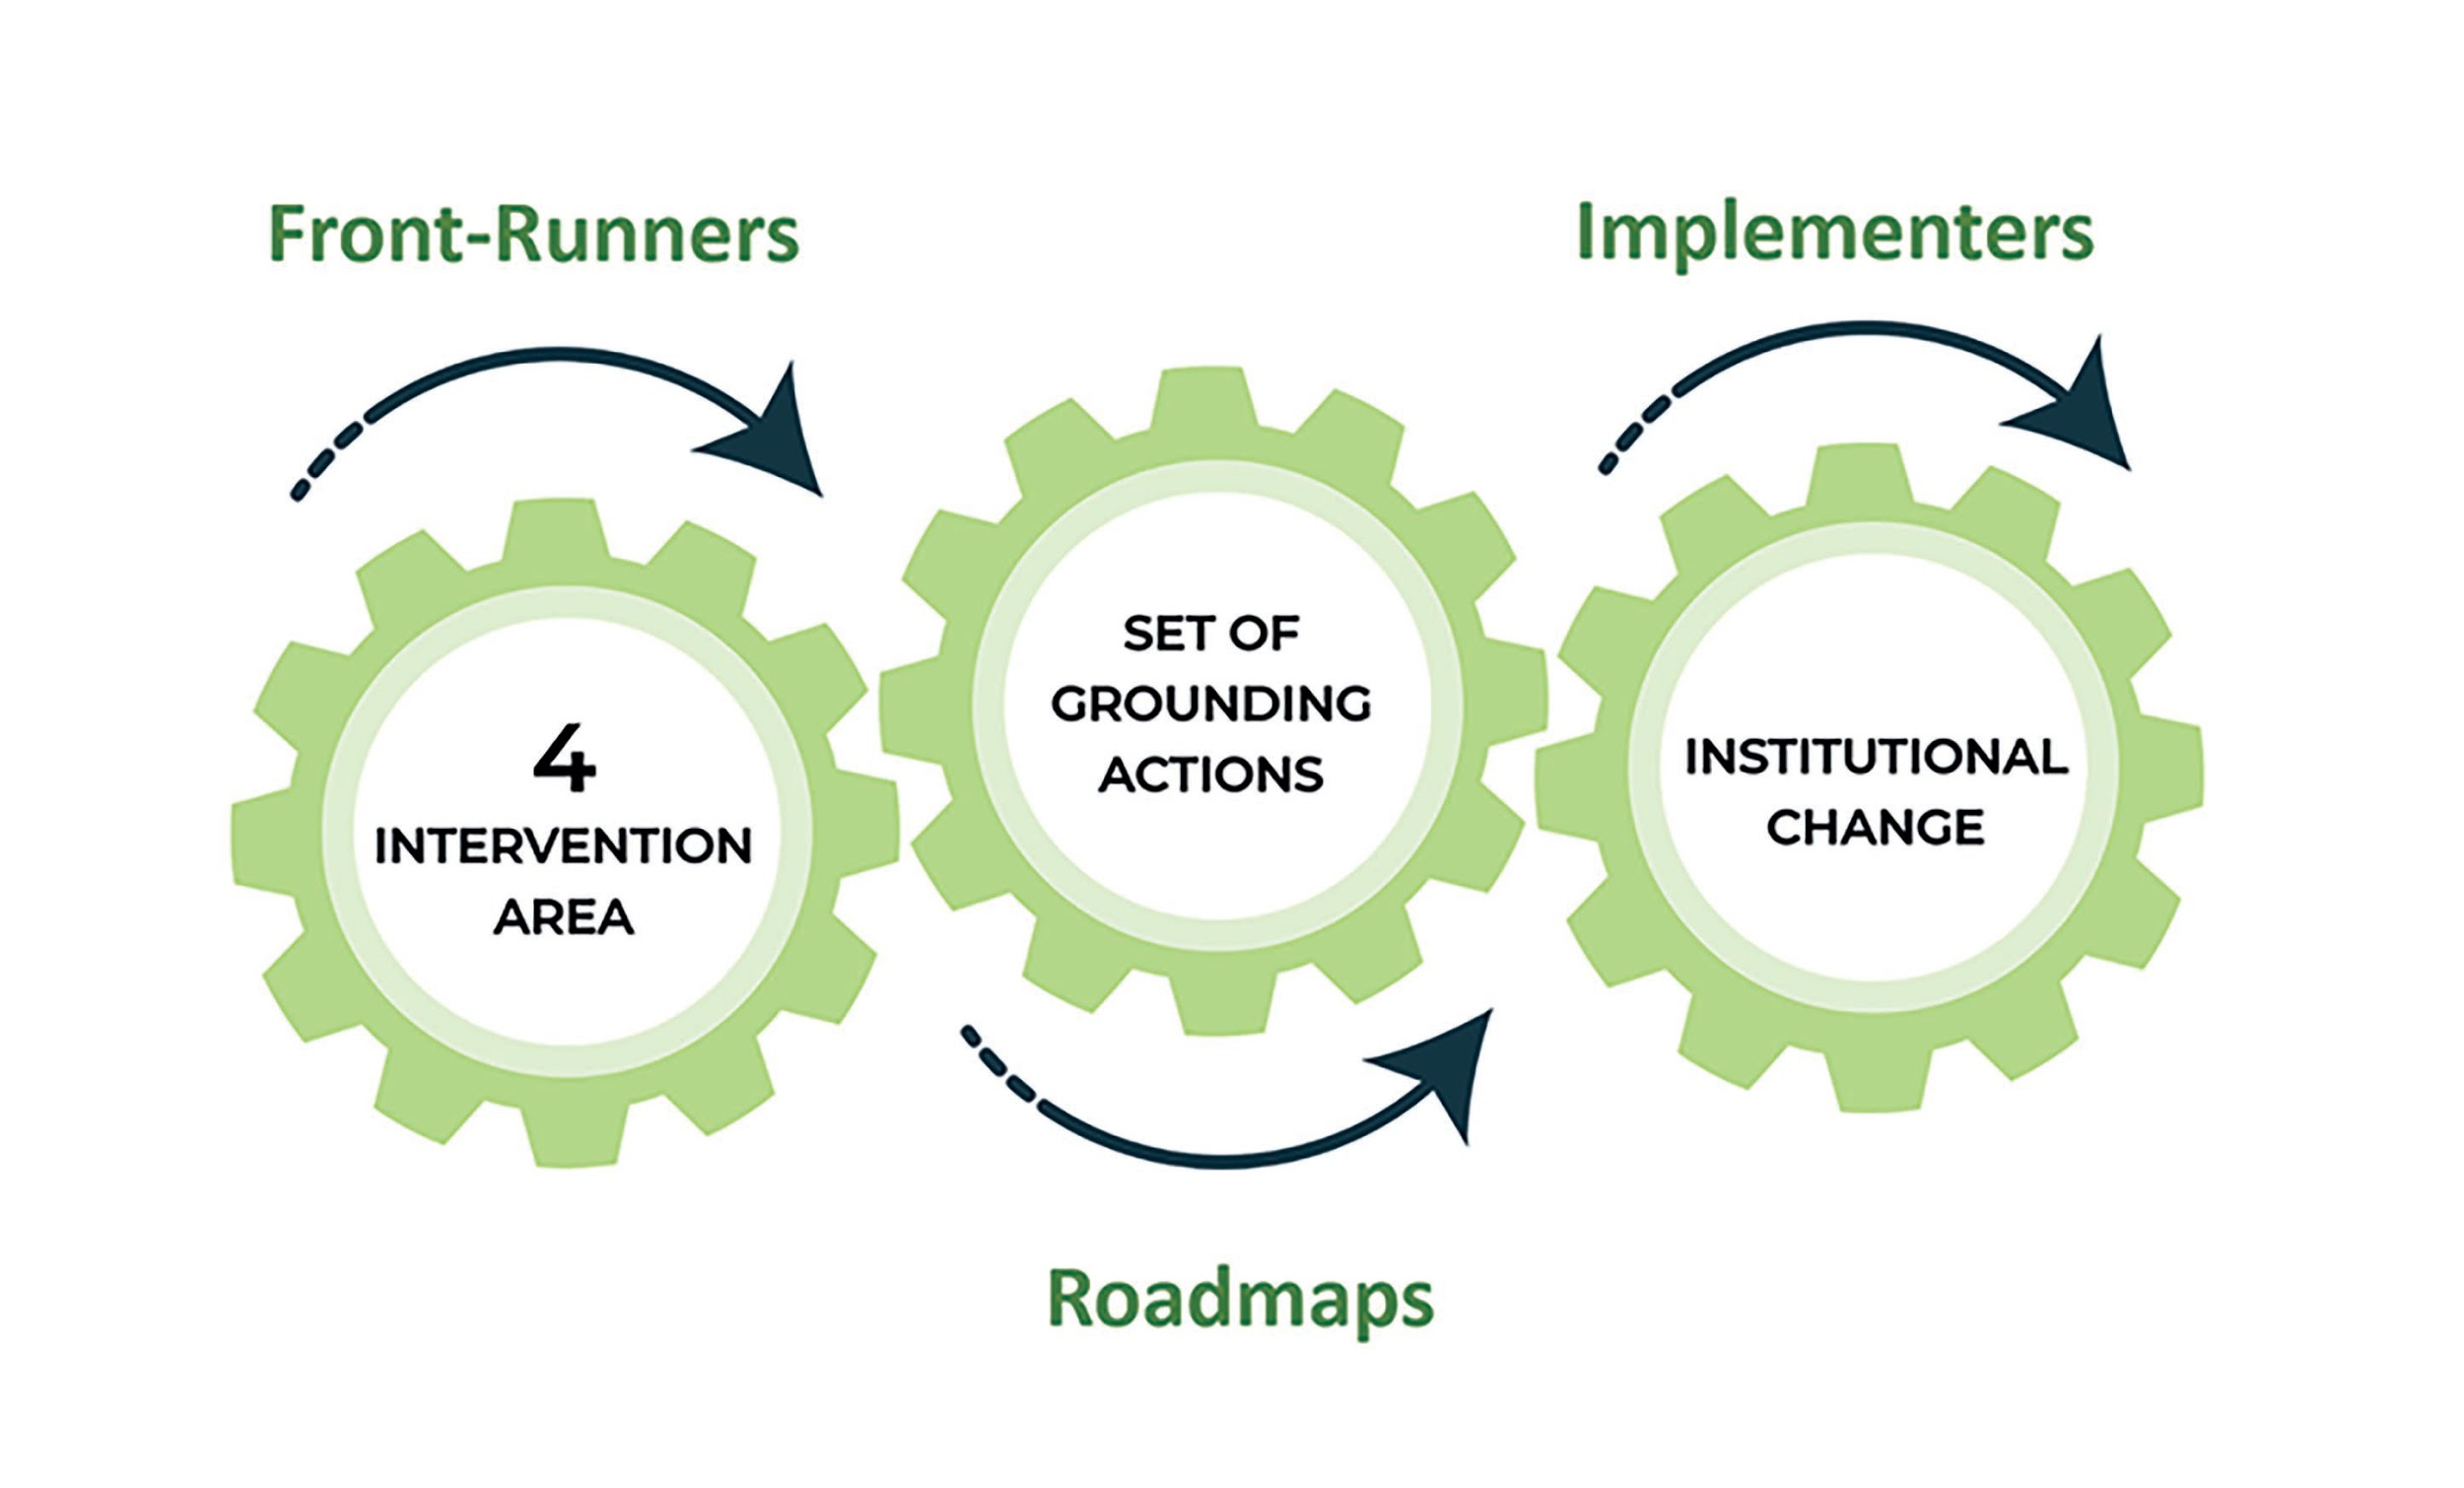
TIME4CS aims at facilitating a way in which the scientific ecosystem could better take societal views into consideration by supporting Research Performing Organisations - i.e. research entities such as universities and research centres - in defining and implementing institutional changes that can lead to a better and more effective engagement of citizens in research and innovation. Those institutional changes inside RPOs will entail transformation of their governance systems by taking into account both the social - mindset of people inside the organisation – and the organisational - norms, protocols, procedures, policy - aspects of RPOs. To facilitate this process, TIME4CS has identified 4 Intervention Areas that alone or combined can stimulate the institutional changes necessary to promote public engagement in R&I activities: Research; Education and Awareness; Support resources and Infrastructure; Policy and Assessment.
For each Intervention Area, a set of Grounding Actions (GA) will be defined. The Grounding Actions are to be considered as seeds to be sown, paving the way to Institutional Changes within research institutions. TIME4CS builds on the close collaboration between Front-Runners - RPOs with a comprehensive expertise in Citizen Science and that have already undergone Institutional Changes and Implementers - beneficiaries still in the early stage of the institutional adoption and/or maintenance of Citizen Science in their organisations.

Slide 11
MSCA PF General tips – Language
Do not use jargon. The evaluators might not be experts in your research area
Explain any abbreviations
Use simple and clear text. Make sure that it ”reads well”
Super tip ! – Start writing early, get feedback from your supervisor and from Grant Office staff, then revise and improve the proposal
Avoid long sentences and too much repetition. Guide your reader to other parts of the proposal e.g.
« For more information on the Infrastructure of Host Institution, please refer to Part B2, Section 5. »
Guide your reader in general using the correct linking words and phrases – you can refer to this useful collections of phrases for academic writing - https://www.qub.ac.uk

Slide 12
MSCA PF General tips – Language cont.
Do not copy and paste information from other documents/websites. Instead adapt information to fit with your proposal.
Do not provide web links to explain information – evaluators are not required to follow links
Include all relevant information in your text
Be consistent with terms used
for example: you can write in 1st person – I plan…, I would like to transfer…, this will be carried out by me
you can write in 3rd person – The researcher has already investigated… , The fellow has been part of this team for…
Whatever your choice is, use it everywhere in your proposal.

Slide 13
MSCA PF B1 – Excellence
1.1 Quality and pertinence of the project’s research and innovation objectives (and the extent to which they are ambitious, and go beyond the state of the art)
1.2 Soundness of the proposed methodology (including interdisciplinary approaches, consideration of the gender dimension and other diversity aspects if relevant for the research project, and the quality of open science practices)
1.3 Quality of the supervision, training and of the two-way transfer of knowledge between the researcher and the host
1.4 Quality and appropriateness of the researcher’s professional experience, competences and skills
Notes:
The overall goal of your fellowship – show the evaluators what you intend to do, introduce yourself, your supervisor, the host institution and state your specific objectives.

Slide 14
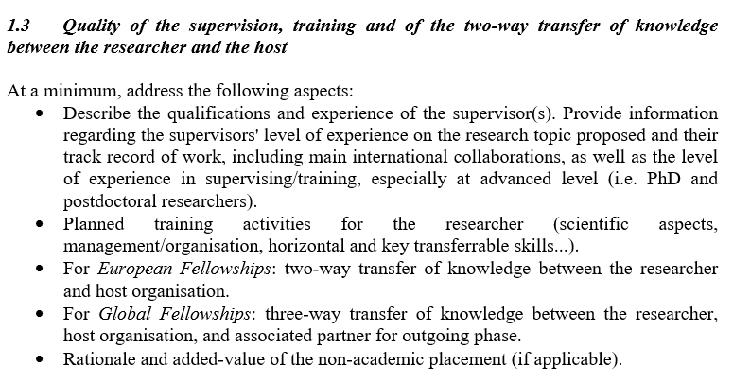
MSCA – PF: Part B1 - Excellence (Supervision & Planned training )
Describe training activities planned for your fellowship – you should include training in: (1) research skills (core skills relating to your project), (2) advanced research skills that will improve your competencies in the research area and (3) transferable skills that you can transfer to future jobs
Examples of advanced research skills: Training in new techniques, instruments, equipment; Open science, Big data; Scientific writing; Experimental design
Examples of transferable skills: management of IPR, project management, task coordination, managing finance, proposal preparation, patent applications, CV preparation and interview skills
The more details you provide on the planned training, the better! (location, course content/topic, date, duration, speaker, etc.)
Provide a short profile of your supervisor & his/her key achievements
Notes:
For European Fellowships your primary supervisor and co-supervisor could be members of the same team within the main host.
If you are doing a secondment you must also have at least one secondment supervisor.
Provide a few sentences on your supervisor & their key achievements:
Number of years experience in the field
Amount of project funding obtained ( give examples of projects – national projects are OK too)
Supervisory experience –number of PhD students, postdoctoral researchers supervised
Number of publications & conferences ( highlights)
Examples of international, intersectoral and interdisciplinary collaborations in his/her area of research

Slide 15
MSCA – PF: Part B1 – Excellence ( 2 way Transfer of Knowledge)
Transfer of knowledge
Fellow > host
Host > fellow
Describe your current expertise, skills, techniques that could be applied to research in host university;
Identify knowledge to address gaps in the host university;
Show that the host can benefit from your existing networks/ contacts;
How you will transfer your knowlege – by mentoring students, delivering workshops to the host team or by initiating contact between your host and past collaborators.
Career Development Plan – a project deliverable that can be updated when needed;
Core & advanced research skills and transferable skills you will develop;
How your supervisor and the rest of the team will enable you to develop core research skills;
Training programmes, workshops, courses offered to you
Support offered by other departments at host;
Networking opportunities
Intersectoral transfer of knowledge – any planned collaborations with business partners where you will get additional skills and insights.
Notes:
This can be achieved based on a Career Development Plan
you and your supervisor need to a plan for you that comprises planned training, planning for publications and participation in conferences – it will be implemented during the fellowship
The main aim is for you to widen your competences as an experienced researcher and gain advanced skills
through TOK from the host

Slide 16
MSCA PF B1 – Impact
2.1 Credibility of the measures to enhance the career perspectives and employability of the researcher and contribution to his/her skills development
2.2 Suitability and quality of the measures to maximise expected outcomes and impacts, as set out in the dissemination and exploitation plan, including communication activities
2.3 The magnitude and importance of the project’s contribution to the expected scientific, societal and economic impacts

Slide 17
MSCA – PF: Part B1 – Communication & Dissemination
2.2 Suitability and quality of the measures to maximise expected outcomes and impacts, as set out in the dissemination and exploitation plan, including communication activities
As regards dissemination:
Describe the international conferences, workshops, networking events that you are planning to join;
Specify high – impact journals, open access journals, other publications;
Describe the target audiences - who will it be? Scientists but also non-scientific groups? Who exactly?
Develop the exploitation plan and how you will manage intellectual property – patents, etc.;
Make sure to mix traditional dissemination methods (publications, conferences) with new methods using digital channels and (social) networks.
As regards communication activities:
Link the strategy communication plan with your project objectives
Specify audiences that you plan to engage with (who ? How many targeted people?)
Plan your communication activities on your project timeline
Decide what kind of communication channels you will use
You may put the details of your communication & dissemination plan into a table.
Notes:
This can be achieved based on a Career Development Plan
you and your supervisor need to a plan for you that comprises planned training, planning for publications and participation in conferences – it will be implemented during the fellowship
The main aim is for you to widen your competences as an experienced researcher and gain advanced skills
through TOK from the host

Slide 18
MSCA – PF: Part B1 – Impact cont.
2.3. The magnitude and importance of the project’s contribution to the expected scientific, societal and economic impacts
Give an indication of the importance of the project’s contribution to the expected outcomes and impacts, should the project be successful. Provide quantified estimates where possible and meaningful.
‘Magnitude’ refers to how widespread the outcomes and impacts are likely to be. For example, in terms of the size of the target group, or the proportion of that group, that should benefit over time;
‘Importance’ refers to the value of those benefits. For example, number of additional healthy life years; efficiency savings in energy supply.
Mid-term and long-term impact of the project
Economic and technological impact
Scientific impact
Societal impact

Slide 19
MSCA PF B1 – Quality and Efficiency of the Implementation
3.1 Quality and effectiveness of the work plan, assessment of risks and appropriateness of the effort assigned to work packages
3.2 Quality and capacity of the host institutions and participating organisations, including hosting arrangements

Slide 20
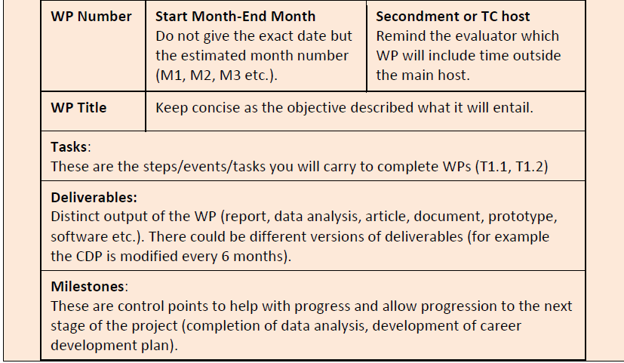
MSCA – PF: Part B1 – Implementation
3.1 Quality and effectiveness of the work plan, assessment of risks and appropriateness of the effort assigned to work packages
A Gantt chart is a must in this part of the proposal
Your Gantt chart should indicate the proposed Work Packages (WP), major deliverables, milestones, secondments, placements. The Gantt chart counts towards the 10-page limit.
A table or list showing all planned work packages (WPs) is also recommended
Recommended number of WPs – 5 or 6.
Identify specific risks that could delay the progress of deliverables (delayed start, equipment failure, insignificant results) & contingency plans. You can put these in a table.
Notes:
It is a good idea to create a WP dedicated to Management, a WP dedidated to Training and a WP dedicated to Commmunication & Dissemination.

Slide 21
MSCA – PF: Part B1 – Gantt Example

Slide 22
MSCA – PF: Part B1 – Obligatory Deliverables
A list of obligatory deliverables - these will have to be included in your work plan!
mobility declaration submitted within 20 days of the start of the research training activities and updated (if needed) via the Funding & Tenders Portal Continuous Reporting tool;
career development plan of the recruited researcher, submitted at the beginning of the action (not later than 6 months after its start) and updated if needed throughout the project
data management plan submitted within the first 6 months of the project;
plan for the dissemination and exploitation of results submitted towards the end of the project
evaluation questionnaire completed by the recruited researcher and submitted at the end of the research training activity; a follow-up questionnaire submitted two years later

Slide 23
MSCA – PF: Part B1 – Implementation cont.
3.2 Quality and capacity of the host institutions and participating organisations, including hosting arrangements
Quality and capacity of the participating organisations, including infrastructure, logistics and facilities should be consistent with Part B-2 Section 5 (“Capacity of the Participating Organisations”).
Participating organisations = your Host institution and a Secondment Host
Provide a table listing the key infrastructure necessary for your planned activities
Example research/technical Infrastructure: equipment, labs, software, technology, data sources, access to end users.
Example Administrative Infrastructure: staff training resources, library use, access to finance office, research office etc.
The hosting arrangements refer to the integration of the researcher to his new environment in the premises of the host.
Explain how you will be integrated into the research group’s environment and the wider host institution – internal meetings, induction days, social activities, refer back to training courses that are offered etc.
Discuss with your Supervisor!
Notes:
At this point you will have very little space
a table - for the research & training activities – at this point you will not have a lot of space within your page limit. ?
Mention briefly whether the host University has policies for the integration of researchers. For example:
If institution has endorsed the Charter & Code,
If they have been awarded the HR Excellence in Research Logo,
Any other employee & recruitment polices.

Slide 24
Any questions ?

Slide 25
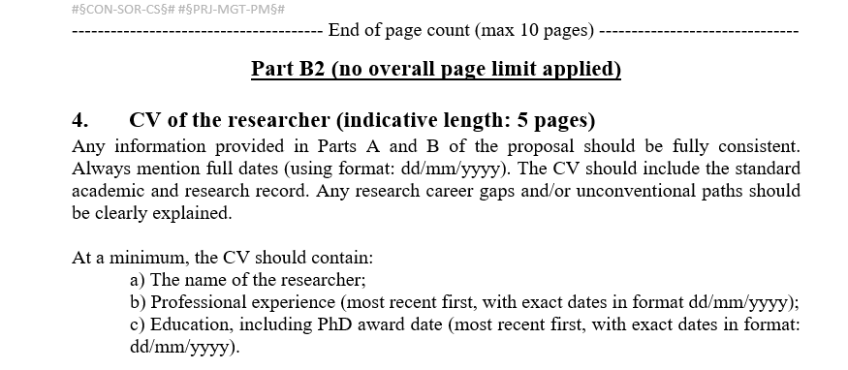
MSCA – PF: Part B2 – CV
You must provide a list of achievements reflecting your track record. Your track record should include: e.g. publications/conference participations, granted patents, monographs, book chapters, examples of leadership in industrial innovation.
If you are not the first or lead author on publications, briefly explain your contribution.
Follow the above recommendations and add other headings if required.
It is important to use the full 5 pages and include all your areas of experience (e.g., teaching, reviewing, consultancy, intersectoral experience, supervision, event organisation, public outreach etc.)
Please note that what you mention here will also be considered by the evaluators in relation to Section 1.4 of Part B1.

Slide 26
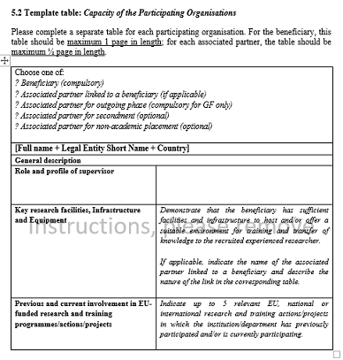
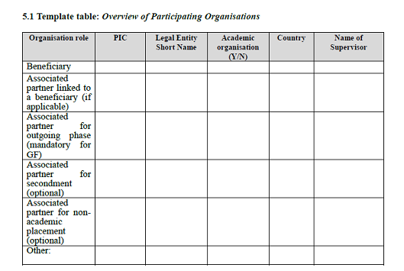
MSCA – PF: Part B2 – tables
Your Supervisor and Grant office will help you fill the tables.
A typical MSCA application = 2 organisations – so you have to fill 2 x 5.2 table

Slide 27
Getting started at UPWr
Get a formal agreement with the Supervisor (an email will be OK)
Register a draft proposal on Funding and Tenders Portal – if you have any problems, contact International Research office
Add your Supervisor and one of us to the proposal as „Contact person”
Download the template for both the B1 and B2 parts.
Start developing the proposal
While in the process of drafting and improving the proposal, we can set up additional meetings – review sessions to keep you on track!
Submission – 10 September 2024 (ideal scenario), 11 September 2024 by 11.00 am at the latest.

Slide 28
MSCA contacts at EU GREEN Universities
Wroclaw University of Environmental and Life Sciences (UPWr) | jowita.chojcan@upwr.edu.pl international.research@upwr.edu.pl
University of Evora | investigar@scc.uevora.pt
University of Parma | raffaele.turri@unipr.it
University of Oradea | rtarca@uoradea.ro
ATU | Juanita.Blue@atu.ie + tara.doherty@atu.ie
University of Angers | cap-europe@univ-angers.fr
OVGU (Madgeburg) | niko.isermann@ovgu.de
Extremadura | amelia.aguilar@fundecyt-pctex.es

Slide 29
Thank you for your time ☺
Funded by the European Union under Agreement nº:101089896. Views and opinions expressed are however those of the author(s) only and do not necessarily reflect those of the European Union or European Union or European Education and Culture Executive Agency (EACEA). Neither the European Union nor the granting authority can be held responsible for them.
Notes:
Poner gracias en todos los idiomas

